Slide 1




EXCELSSIOR EDUCATION SOCIETY’S K. C. COLLEGE OF ENGINEERING AND MANAGEMENT STUDIES AND RESEARCH (Affiliated to the University of Mumbai) Mith Bunder Road, Near Hume Pipe, Kopri, Thane(E)-400603
Department of Computer Engineering
Academic Year 2023-24(Even Semester)

Slide 2
Index
Introduction to Topic
Need of Project
Problem Statement
Literature survey In Tabular Format
Algorithm for Project Development
Flow-chart
Requirement Hardware and Software
Feasibility Study
Proposed Methodology
Detail Design DFD Diagram
Activity Diagram
Screenshots of GUI
References

Slide 3
Introduction to Topic
In the dynamic realm of gaming, effective game development practices are essential for creating engaging experiences and staying competitive. The Hangman project emerges as a comprehensive solution, blending Python technology with gaming mechanics to streamline processes, enhance player engagement, and elevate the gaming experience.
Serving as the central hub for Hangman gameplay, this project provides a platform for word management, user interaction, and gameplay mechanics. By automating routine tasks and incorporating diverse word selections, it aims to deliver seamless and enjoyable gameplay experiences for players across different platforms.
As gaming continues to evolve, the Hangman project plays a pivotal role in fostering creativity, innovation, and enjoyment in the gaming community. This introduction sets the stage for exploring the intricacies and functionalities of the Hangman project, ultimately contributing to the enrichment of gaming experiences for players worldwide.

Slide 4
Need of Project
The necessity for a Hangman Game Management System arises from the increasing demand for streamlined gaming experiences and the pivotal role gaming plays in entertainment and leisure activities. Here are key points highlighting the significance of such a system:
Centralized Game Management: The Hangman Game Management System acts as a centralized platform for storing game data, managing player interactions, and facilitating gameplay mechanics. By consolidating game elements and automating administrative tasks, it enhances efficiency and enables seamless gaming experiences.
Enhanced Player Engagement: Through intuitive user interfaces and interactive features, the system fosters player engagement and immersion in the gaming environment. Features like word selection, difficulty levels, and progress tracking contribute to an enriching gaming experience, driving player satisfaction and retention.
Optimized Processes: Traditional manual game management processes can be cumbersome and prone to errors. The Hangman Game Management System automates tasks such as word selection, letter masking, and scoring, streamlining gameplay and minimizing administrative overhead.

Slide 5
Problem Statement
The Hangman project addresses inefficiencies and disjointed processes within gaming development, hindering player engagement and game quality. Manual handling of tasks such as word selection, player interaction, and gameplay mechanics leads to errors, delays, and suboptimal gaming experiences. Lack of a centralized management system results in fragmented game elements, gameplay inconsistencies, and difficulty in tracking player progress. Additionally, limited communication channels and interactive features diminish player satisfaction and immersion in the gaming environment. To overcome these challenges and elevate gaming experiences, there is a critical need for the implementation of a comprehensive Hangman game management system that streamlines game development processes, ensures gameplay integrity, empowers players, and enhances overall gaming enjoyment.

Slide 6
Literature survey In Tabular Format
Year | Author(s) | Title | State of the System
1894 | Unknown | "Origins of Hangman Game" | Describes the historical roots of Hangman as a pen-and-paper guessing game.
1930 | Edgar Bergen | "Popularization of Hangman" | Mentions Hangman's rise in popularity as a leisure activity.
1960 | William A. Fay | "Hangman in Print" | Hangman becomes a common feature in newspapers and puzzle books.
1975 | Unknown | "Hangman: A Classic Word Game" | Hangman gains recognition as a classic word game for all ages.
1990 | Unknown | "Hangman: Entering the Digital Era" | Introduction of Hangman as a computer-based game.
1995 | Tech Innovators | "Digital Hangman Applications" | Proliferation of Hangman software on personal computers.
2005 | Online Developers | "Hangman Goes Online" | Transition of Hangman to web-based platforms and multiplayer modes.
2010 | Mobile Developers | "Hangman on Mobile Devices" | Advent of Hangman mobile apps for iOS and Android platforms.

Slide 7
Algorithm for Project Development
1. Project Initiation:
a. Define project Objectives: Develop a Hangman Game Management System to enhance gaming experience and
streamline game development processes.
b. Identify key features such as word selection, player interaction, and gameplay mechanics.
c. Assess resources and timeline feasibility for project completion.
2. Planning and Design :
a. Design the UI architecture for Hangman game interface, including player interaction screens and game elements.
b. Create a database schema to store game data, including word bank, player progress, and game settings.
c. Establish connections between different game components, such as word selection, letter input, and game logi
3. Development:
a. Develop core game functionality, including word selection, letter masking, and player interaction.
b. Code game mechanics for player input validation, game progression, and scoring.
c. Implement features for player feedback, game state management, and game over conditions.
4. Testing:
a. Test the game for functionality, including word selection accuracy, letter masking, game logic and bugs.
b. Evaluate user-friendliness through player interaction testing and feedback collection.

Slide 8
Algorithm for Project Development
5. User Testing: a. Conduct beta testing with a small group of players to gather feedback on gameplay experience.
b. Make improvements based on user suggestions, such as adjusting difficulty levels or refining game mechanics.
6. Documentation:
a. Document game architecture, including design decisions and key features.
b. Create instructions for players to easily understand and operate the Hangman game.
7. Project Closure:
a. Verify completion of the Hangman game project and compliance with development standards.
b. Archive project data and records for future reference.
8. Post- Project Review:
a. Evaluate Hangman game performance against initial objectives, such as enhancing player
engagement and streamlining game development.
b. Identify areas for improvement and lessons learned to inform future game development projects.

Slide 9
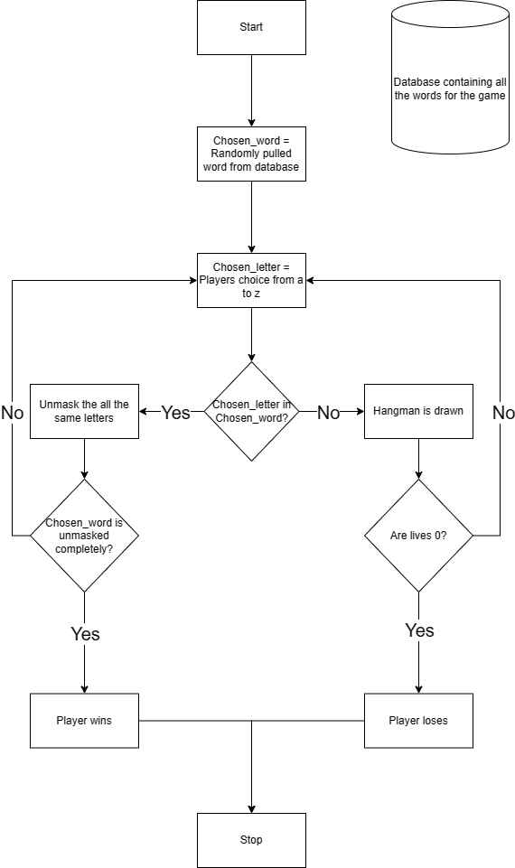
Flow-chart

Slide 10
Requirement Hardware and Software
Hardware :-
Minimum Requirements:
Processor:- Dual core processor @2.4Ghz
Ram:- 4GB Ram
Storage:- 2GB free space
Internet:- speed: 3mbps
Recommended Requirements:
Processor:- Quad core processor @2.8Ghz
Ram:- 8GB Ram
Storage:- 4GB free space
speed: 6mbps
Software :-
Minimum Requirements:
OS: Windows 10 22H2
Python: Version 3.11 with firebase and PyQT5 modules installed.
Recommended Requirements:
OS: Windows 11 22H2
Python: Version 3.12.2 with firebase and PyQT5 modules installed.
Notes:
Need as follows: 1. All Modules of Python should be installed 2. Path of python should be specified 3. OS 10 is required 4. Internet access required

Slide 11
Feasibility Study
Technical Feasibility: The Hangman project requires the latest version of Python and the PyQt5 library for GUI
development. Additionally, access to the internet is necessary for integrating Firebase as the database backend.
Economic Feasibility: Development costs for the Hangman project are manageable within the allocated budget as Python and PyQt5 are open-source technologies. Furthermore, Firebase offers a cost-efficient database solution with flexible pricing options.
Operational Feasibility: The Hangman project aligns with the organization's capabilities and resources, as it leverages widely used programming languages and libraries. Integration into existing operations is feasible with proper planning and implementation.
Legal and Regulatory Feasibility: There are no significant legal barriers foreseen for the Hangman project. Compliance with relevant data protection and privacy regulations will be ensured, especially when handling user data.
Scheduling and Time Feasibility: The project timelines allow for timely development and deployment, considering the relatively straightforward nature of the Hangman game and the availability of required resources and expertise.
Notes:
a. Python latest module required b. Internet access required

Slide 12
Proposed Methodology
User Interface: -
a. Design an intuitive GUI for the Hangman game, ensuring ease of use for players.
b. Implement a responsive and visually appealing interface that adapts to different screen sizes and devices.
2. Database Management: -
a. Utilize Firebase as a centralized database to securely store game data, including words and player records.
b. Implement efficient data retrieval mechanisms to fetch game information during runtime.
3. Application Logic: -
a. Develop the core game functionalities, including word selection, masking, and player input processing.
b. Implement features such as tracking player progress, managing lives, and determining game outcomes.
4. Technologies Used: -
a. Frontend: PyQt5 for GUI development, providing a robust framework for building interactive applications.
b. Database: Firebase, offering a scalable and real-time cloud database solution for storing and retrieving game data efficiently.

Slide 13
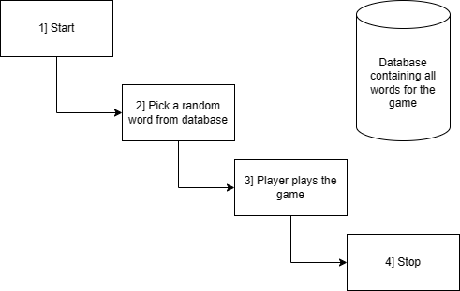
Data Flow Diagram Level 0

Slide 14
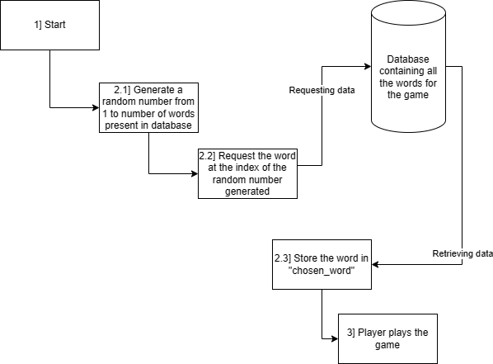
Data Flow Diagram Level 1

Slide 15
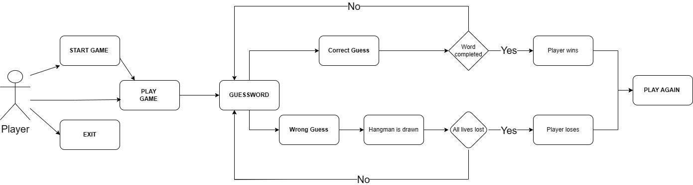
Activity Diagram

Slide 16
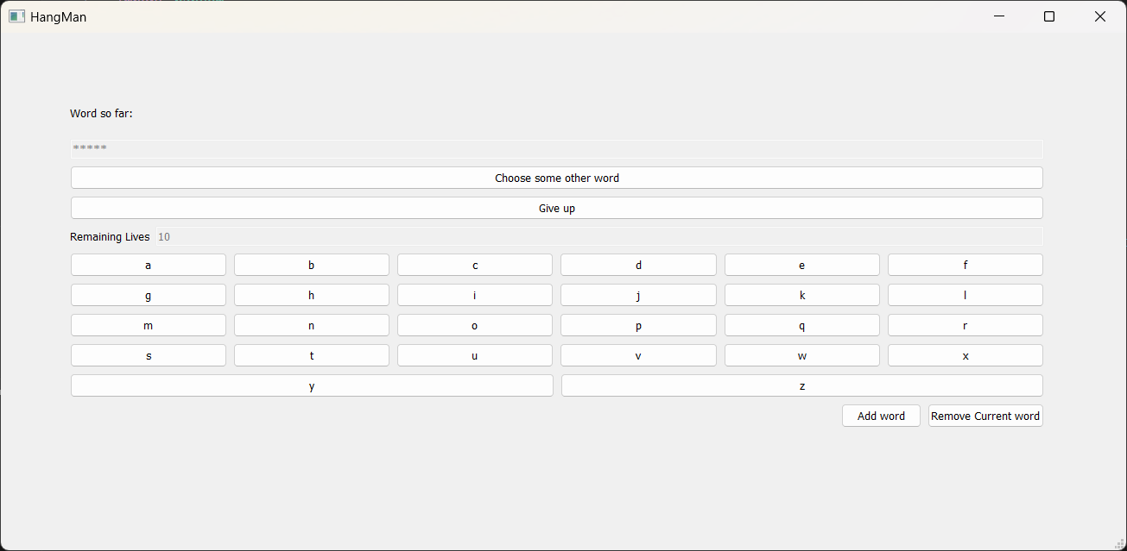
Implementation Details/ Screenshots of GUI
Figure 1 :- The main game screen shown to the user, which can be played instantly. The word is completely hidden and no letters are shown. The player starts with 10 lives and the lives reduce as the incorrect letters are clicked.
Figure 1

Slide 17

Figure 2 :- As the game is played and the letters are clicked, the buttons get disabled. When the correct letter is clicked the letter unhides itself to reveal part of the word.
Figure 2

Slide 18
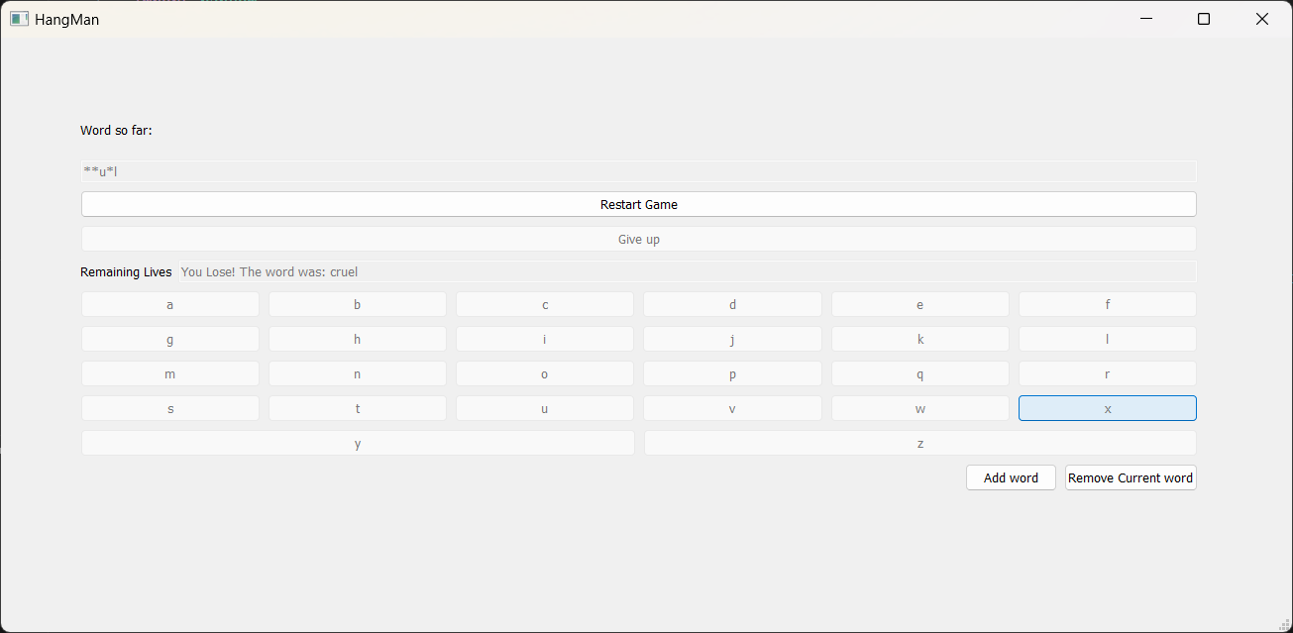
Figure 3 :- When the lives go to 0 for the player, the game ends and the whole word is revealed. The give up button is also disabled as the game is over.
Figure 3

Slide 19
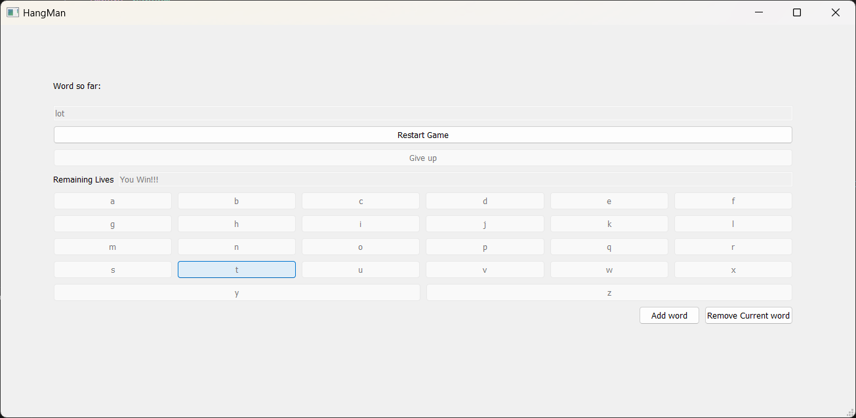
Figure 4 :- If the player wins the game the complete word is shown along with the winning toast and the give up button is disabled as the game has ended.
Figure 4

Slide 20
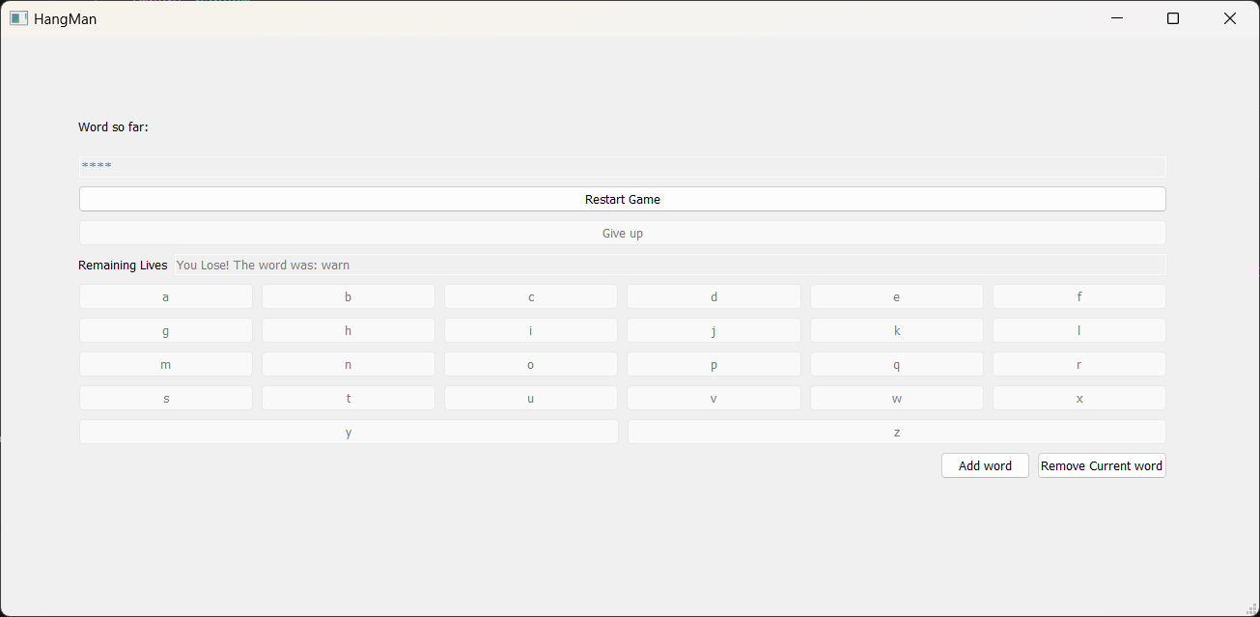
Figure 5 :- When the give up button is used, the losing toast is shown and the word is revealed to the player.
Figure 5

Slide 21
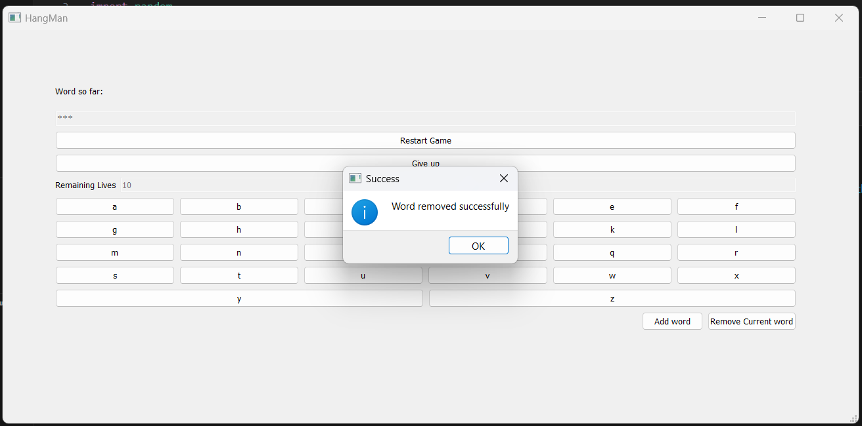
Figure 6 :- Using the remove current word button, completely removes the word from the database so that it wont be used in any client in a new instance.
Figure 6

Slide 22
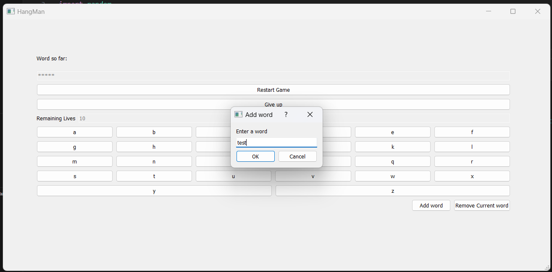
Figure 7 :- When the user clicks on the add word button a new pop up is shown which asks the word to be entered in the dialog box along with the option to finalize the word or to cancel the process.
Figure 7

Slide 23
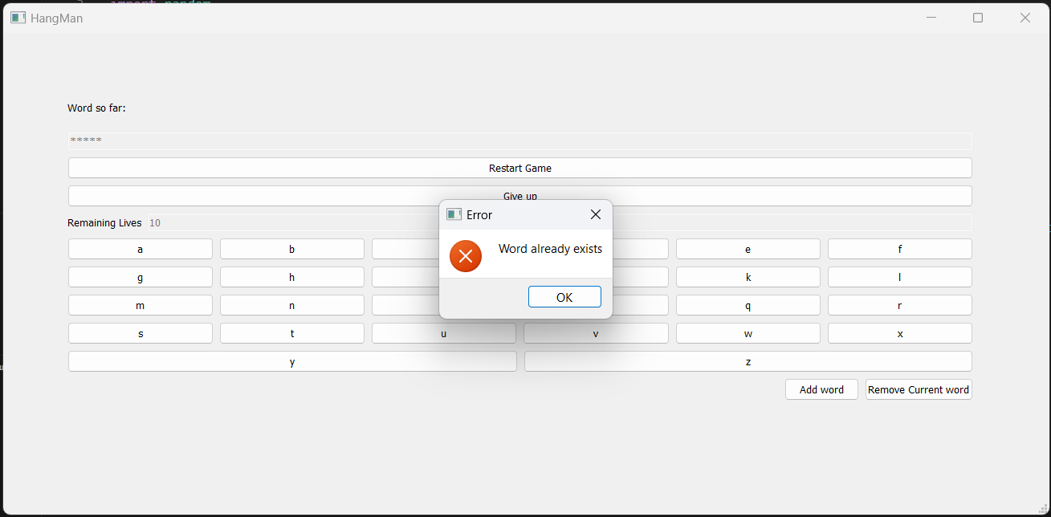
Figure 8 :- The Word which needs to be added is checked against the database to check if it’s a repeated word or not. If the word is repeated then this error is shown.
Figure 8

Slide 24
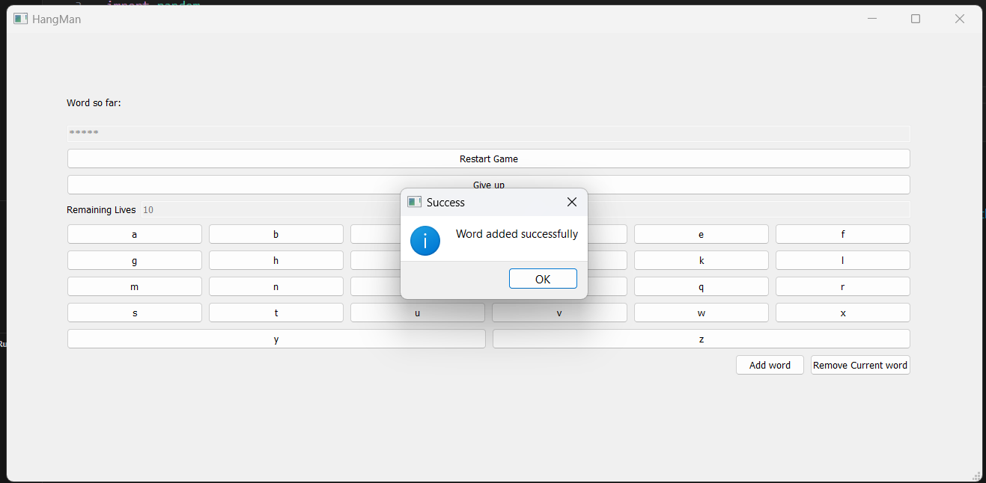
Figure 9 :- If the new word which needs to be added into the database is not found then it is added in the first empty spot found in the database.
Figure 9

Slide 25
References
Chatgpt: Helped in bug fixing along with some help for developing new ideas.
Stackoverflow: Used in solving bugs and getting methods to solve certain issues.
Youtube: Helped in getting new ideas for the project and ways to implement them.
Geekforgeeks: Wording for creating documentation and ppt
Google: Helped in info for parts of ppt and documentation along with random bug fixes.
The Github Repository of this Project with the Source code, Project Report and a copy of this PPT can be found at: Armaan4477/Hangman: Python sem 4 mini project (github.com)

Slide 26
Thank You!!!

